Slide 1
House Bill 96 and Cybersecurity Requirements for local Government entities
Gerard T. Yost
Senior Assistant Prosecuting Attorney
Stark County Prosecutor’s Office

Slide 2
HB 96: Key Cyber Mandates for Local Government Entities
Local Government Entities Must:
  Implement a cybersecurity program
  Obtain approval from their legislative body for ransomware payments
  Cyber incidents must be reported within specific timeframes to DPS and AOS.
  While support is available from several state programs, if you have an existing private-sector or third-party IT and/or Cybersecurity provider, stay the course! There's a lot of work to do and this will take a concerted private-public partnership to succeed.

Slide 3
Building a Cyber Program
The legislative authority of a political subdivision shall adopt a cybersecurity program that:
  Safeguards the entity’s data, information technology, and information technology resources to ensure availability, confidentiality, and integrity.
  The program shall be consistent with generally accepted best practices for cybersecurity, such as,
    National Institute of Standards and Technology (NIST) cybersecurity framework and
    Center for Internet Security (CIS) cybersecurity best practices.
The program MAY include, but is not limited to the following:
Identify functions and risks
Assess the potential impact of a breach
Implement threat detection mechanisms
Establish incident response procedures
Plan for recovery and continuity
Define employee training requirements
  Training from Ohio Persistent Cyber Initiative could satisfy this requirement
requirement.

Slide 4
Auditor of State Bulletin 2024-003
Ohio governments are increasingly falling victim to cybercrimes in the form of payment “re-direct” and business email compromise schemes.
In 2023, the Auditor of State issued an Advisory alerting Ohio governments to an increase in cybercrime and providing guidance on what to look for and how to prevent attacks.
This bulletin sets clear standards and expectations for Ohio governments and public employees regarding the handling of requests for payment re-directs.
AOS has issued FFRs against fiscal officers for failing to follow protocols that resulted in the local government falling victim to cybercrimes.
  Example: changing employee or vendor bank accounts to route payments to the bad actor's account.

Slide 5
Financial Statement Audit
Currently, AOS audits for IT controls in financial audits.
What IT controls do auditors look for currently?
  IT Strategy – (IT planning and IT training)
  Change Management (maintaining support, patches, upgrades)
  Security Management (policies such as IT policies such as cyber policies and cyber awareness training programs)
  System Level Access Controls (multi-factor, password controls, remote access, firewall)
  Application Level Access Controls (multi-factor, role-based access, least privileged access)
  Contracts with Vendors
  Physical Security (contract, locked room, environmentally safe, access protection)
  System Admin & Maintenance (vulnerability checks and monitoring up-time)
  Backup (backups SHOULD BE TESTED and disconnected/offline)
  Disaster recovery & business continuity (plan for what happens in a disaster, should have a copy off-site)

Slide 6
Financial Statement Audit
Currently, AOS audits for IT controls in financial audits.
In other words, the following program elements are already audited by AOS and should be in place now.
With these elements in place, your entity has already made significant strides toward a cyber program.
Program Element (already audited by AOS) | Relevant NIST Cybersecurity Framework (CSF) Function(s) | Relevant CIS Controls v8 (IG1) Reference
IT Strategy (planning, IT training) | Govern (GV) – establish strategy, assign roles. Protect (PR.AT) – awareness & training. | CIS Control 14 – Security Awareness & Skills Training. CIS Control 17 – Incident Response Management (basic planning).
Change Management (patches, upgrades, support) | Protect (PR.MA, PR.IP) – maintenance and secure configuration. Identify (ID.AM) – asset inventory. | CIS Control 7 – Continuous Vulnerability Management. CIS Control 4 – Secure Configuration of Enterprise Assets & Software.
Security Management (policies, cyber awareness training) | Govern (GV) – policies, oversight. Protect (PR.AT) – training. | CIS Control 14 – Security Awareness & Skills Training. CIS Control 2 – Inventory & Control of Software Assets (via policies).
System-Level Access Controls (MFA, passwords, remote access, firewall) | Protect (PR.AC) – identity management, authentication, network access. | CIS Control 5 – Account Management. CIS Control 6 – Access Control Management. CIS Control 12 – Network Infrastructure Management.
Application-Level Access Controls (MFA, role-based access, least privilege) | Protect (PR.AC) – application access, least privilege. | CIS Control 5 – Account Management. CIS Control 6 – Access Control Management.
Contracts with Vendors | Govern (GV.SC) – supply chain risk management. | CIS Control 15 – Service Provider Management.
Physical Security (locked rooms, contracts, environmental safety) | Protect (PR.PH) – physical security & environmental protections. | CIS Control 16 – Application Software Security (partial). CIS Control 12 – Network Infrastructure (physical protections).
System Admin & Maintenance (vulnerability checks, uptime monitoring) | Protect (PR.MA) – maintenance. Detect (DE.CM) – monitoring. | CIS Control 7 – Continuous Vulnerability Management. CIS Control 8 – Audit Log Management.
Backup (tested, disconnected/offline) | Protect (PR.DS) – data security. Recover (RC.RP) – recovery planning. | CIS Control 11 – Data Recovery.
Disaster Recovery & Business Continuity (off-site copy, recovery planning) | Recover (RC.RP, RC.IM) – recovery planning, improvements. | CIS Control 11 – Data Recovery. CIS Control 17 – Incident Response Management (continuity).

Slide 7
WHO MUST COMPLY & WHEN
Applies to all political subdivisions:
“Political Subdivision” means any county, township, municipal corporation, or other corporate and politic responsible for governmental activities in a geographic area smaller than that of the state.
Auditor of State compliance timeline for Cyber Programs:
  Counties and Cities must have a program in place by January 1, 2026
  All other entities must have a program in place by July 1, 2026
  Compliance Timeline to begin reporting to Department of Public Service and the Auditor of State is September 30, 2026

Slide 8
Ransomware Payment Restrictions
(B) A political subdivision experiencing a ransomware incident shall not pay or otherwise comply with a ransom demand unless the political subdivision's legislative authority formally approves the payment or compliance with the ransom demand in a resolution or ordinance that specifically states why the payment or compliance with the ransom demand is in the best interest of the political subdivision.
Section 121.22 (F)– Emergency meeting can be called with less than 24 hours notice and still be in compliance with Open Meetings
New Requirement
Local governments may not pay or comply with ransomware demands unless:
A formal resolution or ordinance is passed
The resolution must justify why payment is in the best interest of the jurisdiction

Slide 9
Definition of Reportable Incidents RC 9.64(A)(1)
A substantial loss of confidentiality, integrity, or availability of a covered entity's information system or network;
A serious impact on the safety and resiliency of a covered entity's operational systems and processes;
A disruption of a covered entity's ability to engage in business or industrial operations, or deliver goods or services;
Unauthorized access to an entity's information system or network, or nonpublic information contained therein, that is facilitated through or is caused by:
  A compromise of a cloud service provider, managed service provider, or other third-party data hosting provider; or
  A supply chain compromise.
"Cybersecurity incident" does not include mere threats of disruption as extortion; events perpetrated in good faith in response to a request by the system owner or operator; or lawfully authorized activity of a United States, state, local, tribal, or territorial government entity.

Slide 10
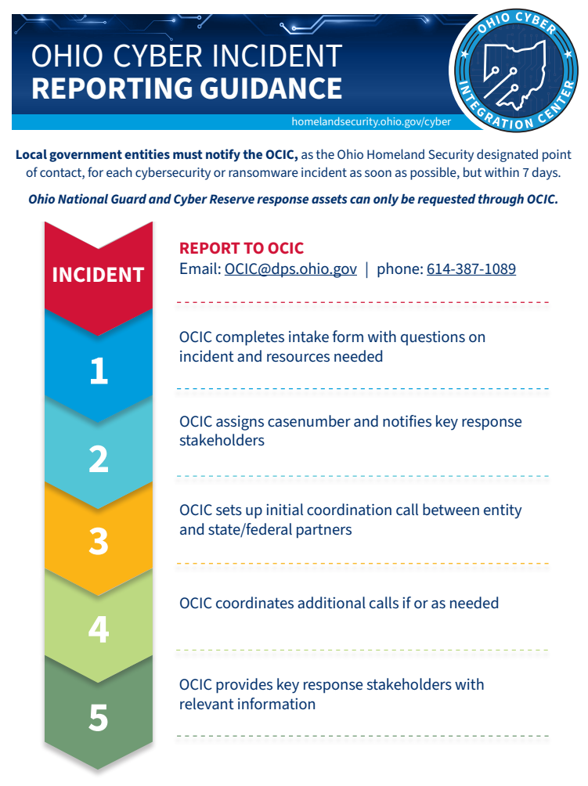
OCIC INCIDENT REPORTING PROCESS
Within 7 Days of Incident:
    1. Affected entity contacts OCIC
    - Intake form completed (under NDA)
    - Case number generated, stakeholders notified
    2. Initial Coordination Call Setup:
    - DAS OISP, DPS IT/LEADS, SoS (election), FBI, DHS, CISA
    - Ohio Cyber Reserve & ONG (if requested, VOCO required)
    3. OCIC facilitates response coordination & tracking
    - Case management system used for tracking & documentation
    4. Follow-up Calls (as needed):
    - Forensics, mitigative actions, TTPs/IOCs, reconnection, AAR
    5. OCIC shares final disposition & anonymized lessons learned

Slide 11
Contact Info to Report:
Ohio Cyber Integration Center
  Phone: 614-387-1089
  Email: OCIC@dps.ohio.gov
  Website: https://homelandsecurity.ohio.gov/ohio-cyber-integration-center
Ohio Auditor of State
  Phone: 866-FRAUD-OH
  Reporting Form: ohioauditor.gov/fraud/docs/CybersecurityReportingForm.pdf
  Email: cyber@ohioauditor.gov
  Website: www.ohioauditor.gov

Slide 12
INCIDENT INFORMATION REQUIREMENTS
Auditor of State
Report as soon as possible, but no later than 30 days upon discovery of an incident
Questions on AOS Report Form include:
  POC: name, title, email, phone
  Government entity type
  Date/time of incident and type of incident
  Was any data compromised?
  Was there a loss of funds? If yes, how much?
  Was ransom demanded? If so, was it paid?
  If ransom was paid, what is the ordinance or resolution approving payment?
  Were policies and procedures in place at the time of the event?
Ohio Cyber Integration Center (DPS)
Organization Details & Contact Info:
Name, Address, County, Phone, Org Type
POC: Name, Title, Phone, Email
Security Team Details:
Device count, PPI, state connected device?
Last backup date
Incident Specifics:
Date/Time of incident or suspicious activity
Type of incident, mitigation steps taken prior to reporting
Affected devices removed/turned off?
Cyber insurance status & provider contacted?
Others contacted regarding incident?

Slide 13
PUBLIC RECORDS EXEMPTION
Records related to:
Cybersecurity programs
Incident reports and procurement documents are not public records under R.C. §149.43
This protects the confidentiality of sensitive systems and responses.

Slide 14


Cybersecurity Training: O-PCI
Free Cybersecurity Training for Local Government Entities
Whole-of-organization training
Tailored to the roles of employees (Executive/IT/General)
Includes online modules, creation of plans/policies/procedures, cyber exercises, and vulnerability assessments
The O-PCI program delivered by the Ohio Cyber Range Institute (https://www.ohiocyberrangeinstitute.org/opci) and the Ohio Cyber Reserve (https://homelandsecurity.ohio.gov/ohio-cyber-integration-center/overview) includes online, hybrid and in person modules tailored to various types of organizations, from small to large, rural to urban and is funded by the State and Local Cybersecurity Grant Program.
BONUS Resource: Cyber Frontline First Aid Kit (CFFAK)
9,000+ public employees have completed 8,000+ hours of training in counties, cities, libraries, schools, and health districts across Ohio.
ohiocyberrangeinstitute.org/cffak

Slide 15
WATER & WASTEWATER CYBER THREATS
Water and wastewater systems are some of the most targeted entities for cyber attacks
Assistance for water entities through Ohio Cyber Reserve is available.
  Free Cyber assessments
  Guidance on mitigation
  Guidance on cyber program development
The Ohio Cyber Reserve is actively reaching out to water and wastewater systems to offer support.
http://ohcr.ohio.gov/

Slide 16
HOW TO USE COLLECTIVE DEFENSE
Local governments don’t have to do this in isolation. There are ways to reduce duplication and share expertise:
Shared Threat Intel: Participate in MS-ISAC and OCIC alerts—this gives MSPs and local IT staff common early warning.
Shared Playbooks: Use state-provided templates for IR plans, ransomware runbooks, and board resolutions.
Regional Partnerships: Pool with nearby counties/municipalities for joint tabletops, exercises, or staff training—what matters is demonstrating that your program is “reasonable and appropriate,” not that it’s identical everywhere.
Using Aggregate Purchasing Pathways
Cooperative Purchasing:
  Buy endpoint protection, secure email, backup/DR, or monitoring tools at statewide rates.
  This lowers cost for small jurisdictions and ensures products meet state baseline standards.
Shared MSP Services: Some councils of governments, county IT departments, or regional planning commissions already contract MSPs and can extend services to member LGEs.
Training & Awareness: Utilize aggregate networks like the O-PCI and CFFAK.
Putting it Together: Division of Roles
Board/Council: Adopt program, approve policies, sign off on annual CSF profile and any ransom decision.
Local Executive (Mayor, Administrator, Superintendent, Director): Designated accountable official.
MSP: Operates day-to-day technical controls, monitoring, patching, backups, and provides reporting.
Collective Defense & Cooperative Purchasing: Supply playbooks, templates, shared intelligence, and discounted procurement.

Slide 17
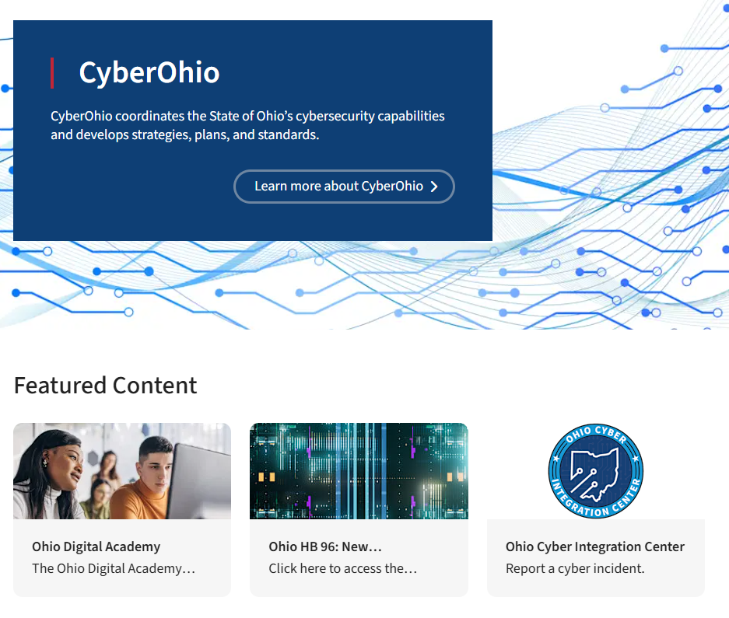
REGISTER FOR UPCOMING EVENTS AT CYBER.OHIO.GOV
REGISTER FOR THE CYBEROHIO WEBINAR SERIES EVERY 2 WEEKS
JOIN CYBER OHIO NEWSLETTER
FIND ADDITIONAL HB 96 RESOURCES, VIDEOS AND SLIDES ONLINE

Slide 18
QUESTIONS ?

